Slide 1
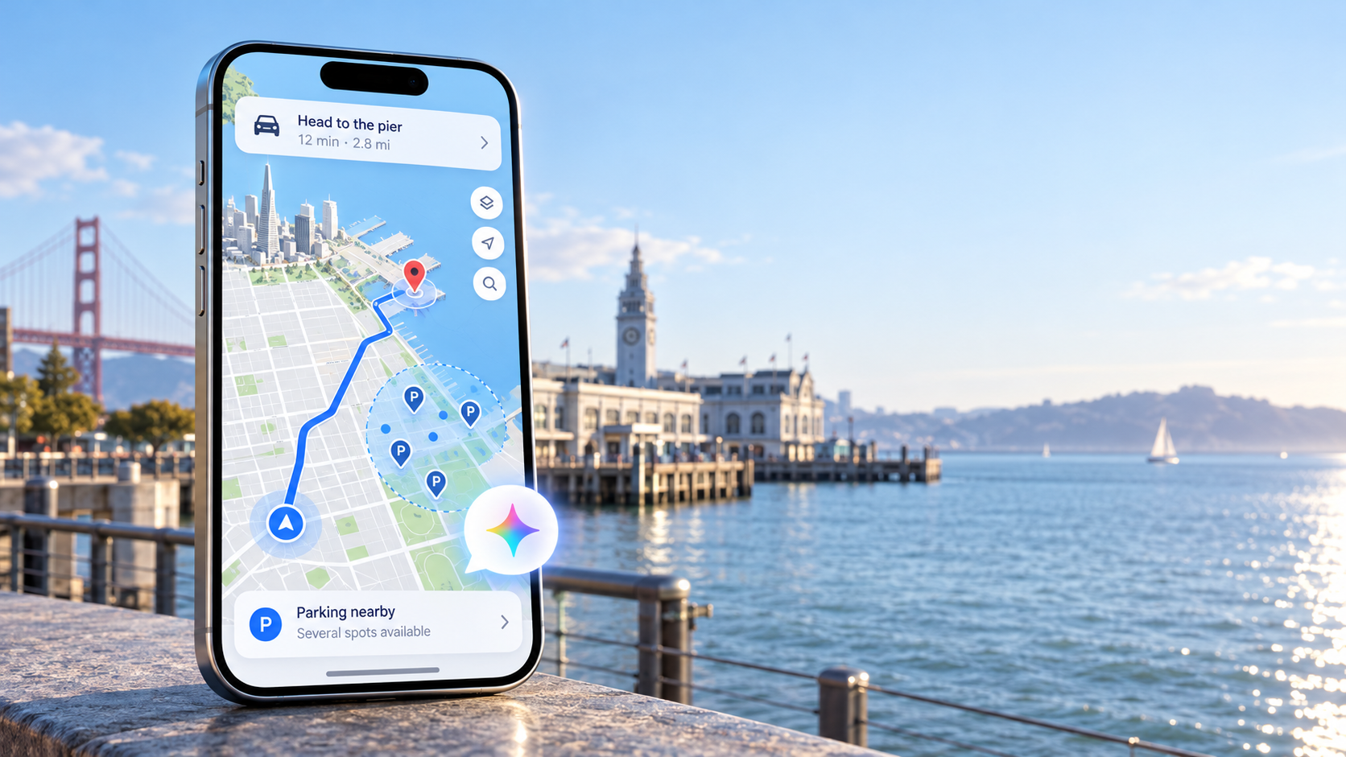
AI PRODUCT CONCEPT
Google Maps
Smart Arrival
Parking-aware route planning powered by Gemini
A product concept that turns parking from a reactive POI search into an AI-assisted arrival strategy.
Product strategy · AI behavior · Prototype · Evaluation · Launch

Slide 2

The problem starts where navigation ends
Dense-city driving creates an arrival gap: navigation ends at the pin, but the trip ends at the entrance.
The actual goal is not “reach a coordinate”
The driver still needs to park legally and walk to the entrance.
Parking appears as a separate search task after route choice.
Options are hard to compare while driving: detour, walk, price, restrictions and uncertainty.
Street parking must be framed as likelihood and search zones, not guaranteed open spaces.
Opportunity: make parking intent part of route planning.
Google Maps Smart Arrival · AI Product Concept
2

Slide 3
From “find parking” to “plan arrival”
The AI feature is not a parking search. It is a decision system for the final stretch of the journey.
Current experience
Product principle
Destination
Start driving
Ask for parking
Inspect list
Reroute
Do not make the driver compare a list while moving.
Gemini should understand the intent, then recommend one useful next action.
Parking is reactive. The driver has already committed to a route before seeing tradeoffs.
Proposed experience
Destination
Parking intent
Ranked strategies
Start
Drive · Park · Walk
LOWER COGNITIVE LOAD
Parking becomes a route constraint: Maps compares total arrival cost before navigation begins.
Google Maps Smart Arrival · AI Product Concept
3

Slide 4
Why this is an AI feature
The AI value is not “show parking nearby.” The value is translating messy user intent into a grounded arrival decision.
Traditional search
Gemini behavior
Grounded output
“Show parking near Pier 3.”
“I don’t mind walking five minutes, but I’d rather park on the street.”
“Street parking along the Embarcadero is the best fit. It adds ~3 minutes and leaves a 4-minute walk.”
Returns a list of nearby garages or lots. The user still compares distance, detour, walk and price manually.
Understands preference, extracts constraints, ranks strategies and recommends one action.
The model does not invent availability. It reasons over structured route, parking and confidence data.
Google Maps Smart Arrival · AI Product Concept
4

Slide 5
AI system logic: interpret → ground → recommend
Gemini owns the conversational reasoning. Product data owns the facts.
1. Interpret
2. Extract
3. Rank with data
4. Recommend
Natural-language parking intent
Type, walk limit, cost, urgency
Route + parking + price + confidence
One driving-safe next action
Safety boundary
Gemini can recommend search zones with confidence; it must not claim a specific street space is open unless trusted live data supports it.
Google Maps Smart Arrival · AI Product Concept
5

Slide 6
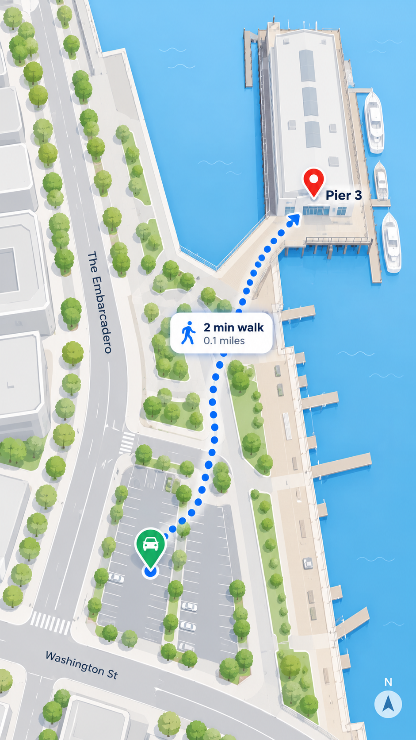
The experience: one continuous journey
A small intervention before Start prevents the driver from solving parking under pressure.
Turn right · The Embarcadero
Arrival strategies
Gemini
Embarcadero curb · +2 min · 2 min walk
Gemini
Parking may be difficult
Pier-area garage · +8 min · $18
Better street parking found
Plan before you start?
Adds 3 min · 4 min walk
Plan parking
Parking prompt
Arrival options
Gemini reroute
Park → walk
Golden path: search Pier 3 → plan parking → compare strategies → start navigation → Gemini adapts route → park → walk to entrance.
Google Maps Smart Arrival · AI Product Concept
6

Slide 7
The core PM decision: rank arrival tradeoffs
The feature should optimize total arrival, not straight-line proximity to a garage.
Option
Detour
Search
Walk
Cost
Confidence
Embarcadero curb
Street zone · Recommended
+2 min
~3 min
2 min
Metered
High
Rule
Street parking is a probabilistic zone.
Garages are concrete destinations.
Both can be ranked by total arrival cost.
Washington St
Street zone
+4 min
~4 min
4 min
Metered
Medium
Pier-area garage
Garage
+8 min
—
2 min
~$18
Known
Google Maps Smart Arrival · AI Product Concept
7

Slide 8
Visual direction: planning stays 2D, driving becomes immersive
2D planning
Search, destination details and route comparison remain map-first and overhead.
3D navigation
After Start, the camera tilts forward with buildings, route corridor, vehicle marker and highlighted curb zones.
Gemini surface
Compact, driving-safe: one recommendation and one action instead of a long list.
Google Maps Smart Arrival · AI Product Concept
8

Slide 9
AI evaluation plan
The portfolio story should show how the feature would be tested, not only how it looks.
Model quality
Experience quality
Product quality
Intent classification
Task completion
Smart Arrival adoption
Constraint extraction
Voice turns required
Route acceptance
Unsupported claim rate
Decision time
Reroute acceptance
Recommendation relevance
Driver confidence
Arrival completion
Benchmark examples: “Find street parking near Pier 3,” “I can walk five minutes,” “Avoid garages,” “I’m already late.”
Google Maps Smart Arrival · AI Product Concept
9

Slide 10
Risk and safety plan
Smart Arrival must be useful without pretending it has certainty it does not have.
False availability
Stale restrictions
Never claim a specific street space is open without reliable live data.
Surface time-sensitive uncertainty and prompt users to check posted signs.
Driver distraction
Low confidence
After Start, Gemini summarizes and recommends one action.
Fallback to garages or broader search zones when curb confidence is weak.
Product guardrail: confidence labels are part of the interface, not an implementation detail.
Google Maps Smart Arrival · AI Product Concept
10

Slide 11
Success metrics and rollout strategy
Start narrow, learn from arrival behavior, then expand.
01
SF beta
02
Dense-city expansion
03
Scale
Embarcadero / SoMa / North Beach
More curb data + garages
Personalized arrival planning
Activation
users who plan parking before Start
Recommendation quality
selected plan vs changed / abandoned plan
Safety
unsupported claim rate + correction rate
Outcome
successful arrival completion + walking handoff
Google Maps Smart Arrival · AI Product Concept
11

